Slide 1
Retail Sales Insights & Demand Forecasting
Capstone project
Name: Shridevi Kulkarni

Slide 2
Objective:
• Analyze Walmart’s retail sales data
• Identify key patterns and drivers of weekly sales
• Build a predictive model to estimate sales
• Provide business insights and recommendations
Business Importance:
Better understanding of sales patterns helps optimize:
• Inventory
• Marketing
• Promotions
• Store planning
PROJECT OBJECTIVE

Slide 3
DATASET OVERVIEW
Files Used:
• train.csv
• features.csv
• stores.csv
Dataset Summary:
• ~421,000 rows
• 45 stores
• 81 departments
• Variables include weekly sales, holidays, store type, size, fuel price, CPI, unemployment.
Final dataset created by merging all three files.

Slide 4
DATA CLEANING PROCESS
Steps Performed:
• Merged train, features, and stores datasets
• Converted Date → datetime format
• Created Year, Month, Week features
• Filled missing values using median
• Removed duplicates
• Encoded categorical features
• Final cleaned dataset ready for EDA & modeling

Slide 5
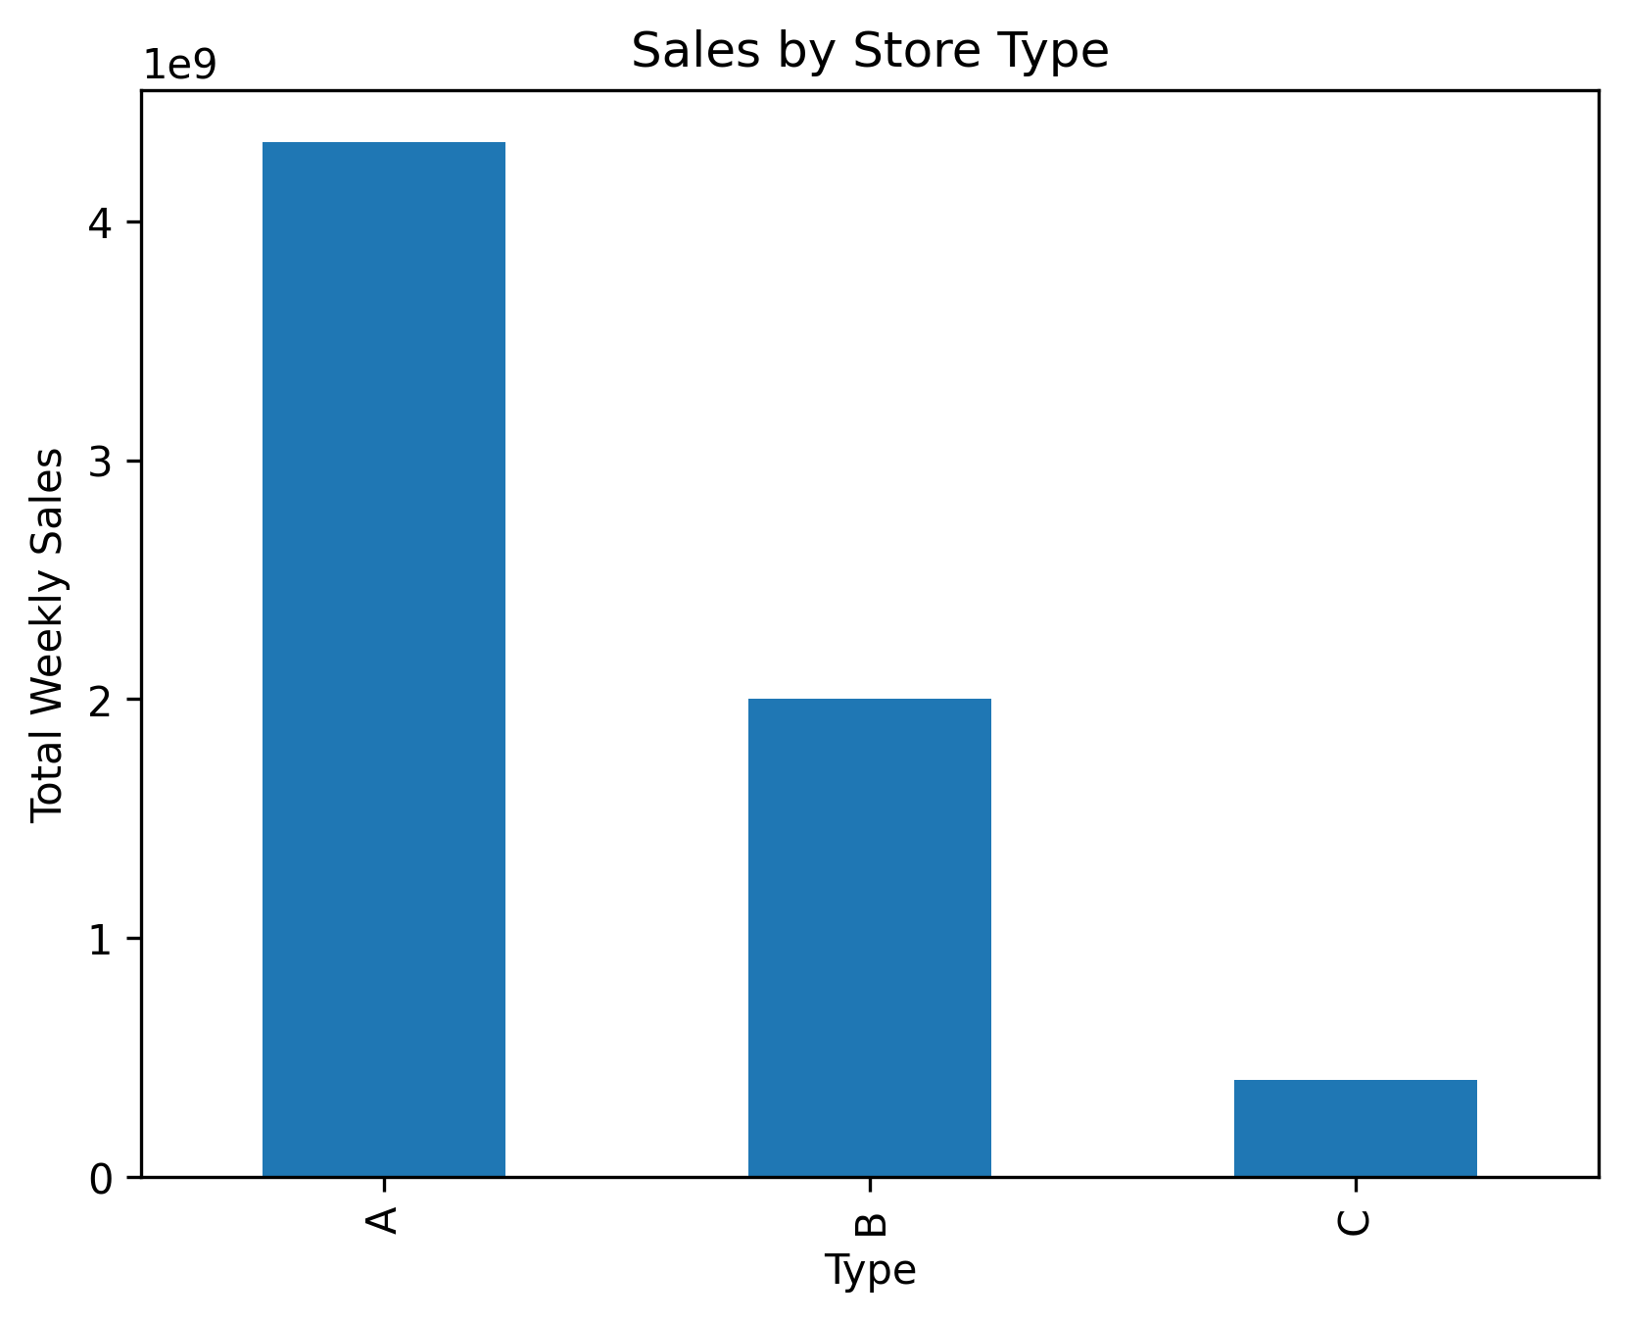
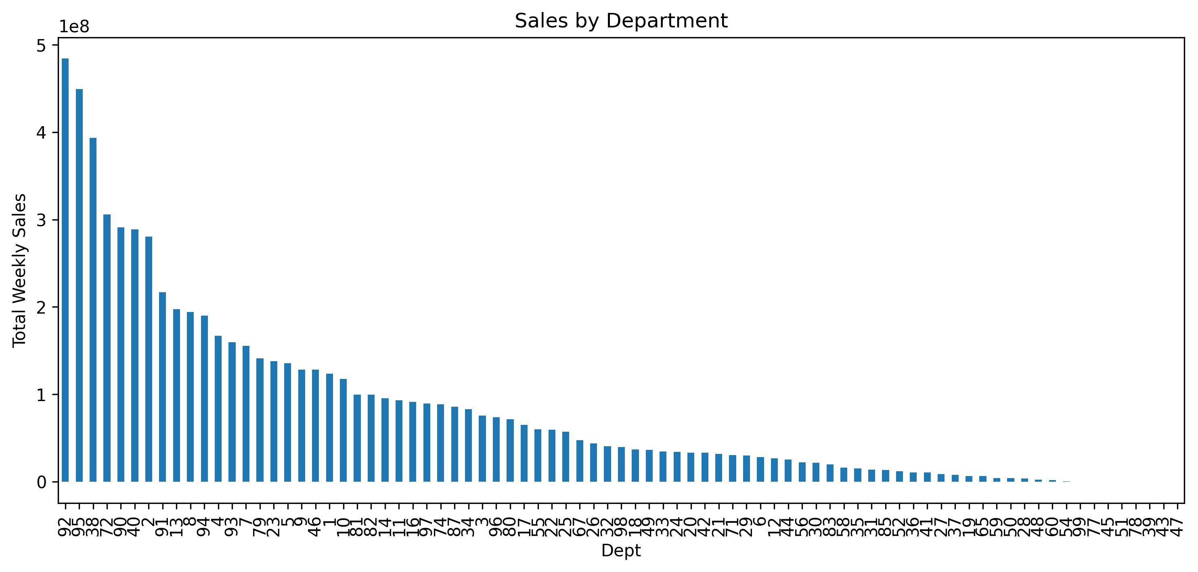
EXPLORATORY DATA ANALSIS
•Key Insights:
• Sales show seasonal patterns
• Store Type A has the highest sales
• Holidays increase average sales
• Department contributions vary widely
• Correlations with external factors are weak

Slide 6
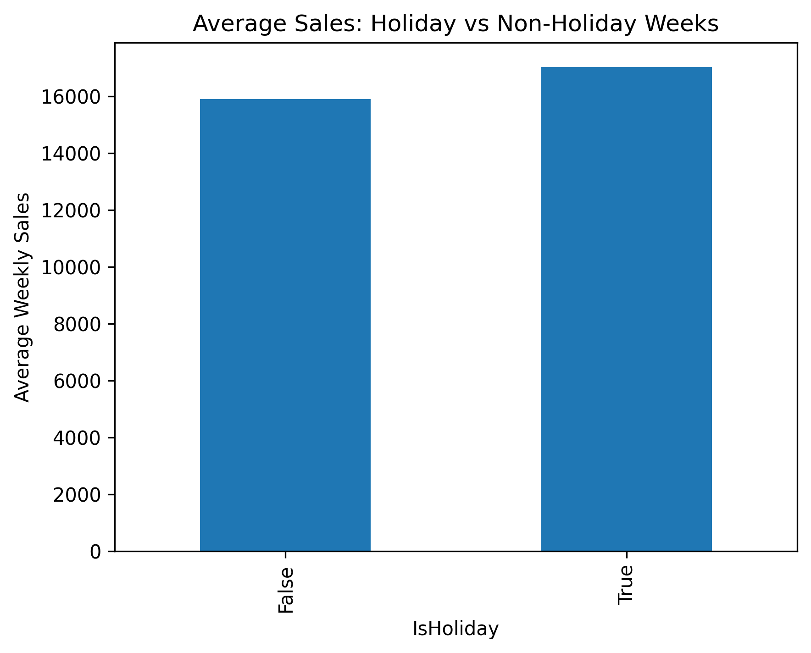

Slide 7
Statistical Tests (T-Test + ANOVA)
T-Test: Holiday vs Non-Holiday Weeks
• Purpose: Check if holidays impact weekly sales
• t-statistic: 7.00
• p-value: 2.59 × 10⁻¹²
• Conclusion:
• Holidays significantly increase weekly sales
• Reject H₀ → There IS a difference
ANOVA: Sales by Store Type (A, B, C)
• Purpose: Compare sales performance across store types
• F-statistic: 7764.43
• p-value: 0.0
• Conclusion:
• Store Type C > Type A > Type B
• Store type has a strong impact on sales
• Reject H₀ → Store types differ significantly
Key Insight:
Holiday periods and store type heavily influence weekly sales — statistically proven.

Slide 8
MODEL SUMMARY
Model Used: Linear Regression
Target: Weekly Sales
Input Features: Store, Dept, Holiday, Year, Month, Week, Size, Temperature, Fuel Price, CPI, Unemployment, Store Type
Model Performance:
• R² Score: 0.09
• MAE: 14,570
• RMSE: 21,767
Interpretation:
Retail sales are highly variable due to promotions/events not in the dataset → so low R² is expected.
But the model is still useful for identifying key sales drivers.

Slide 9
KEY DRIVERS & FINAL INSIGHTS
Top Positive Influencers
• Type C Stores
• Holiday Weeks
• Certain Months
• Fuel Price
• Dept Number
Top Negative Influencers
• Type B Stores
• Unemployment
• CPI
• Year (downward trend)

Slide 10
CONCLUSION
• Holidays significantly boost sales
• Store Type C performs best
• Economic factors affect demand
• Sales show seasonal trends
• Insights can guide inventory, marketing & pricing decisions

